Slide 1
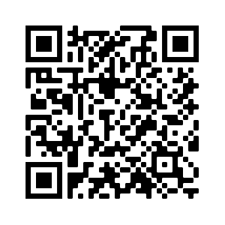
AS A PART OF YOUR ONBOARDING CHECKLIST, REMEMBER TO
Register to Vote:
CivicHealthAlliance.org

Slide 2
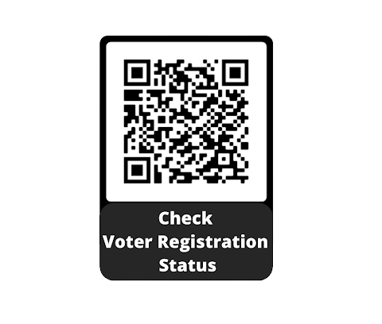
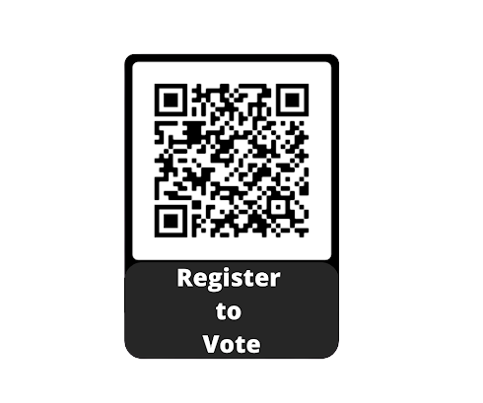
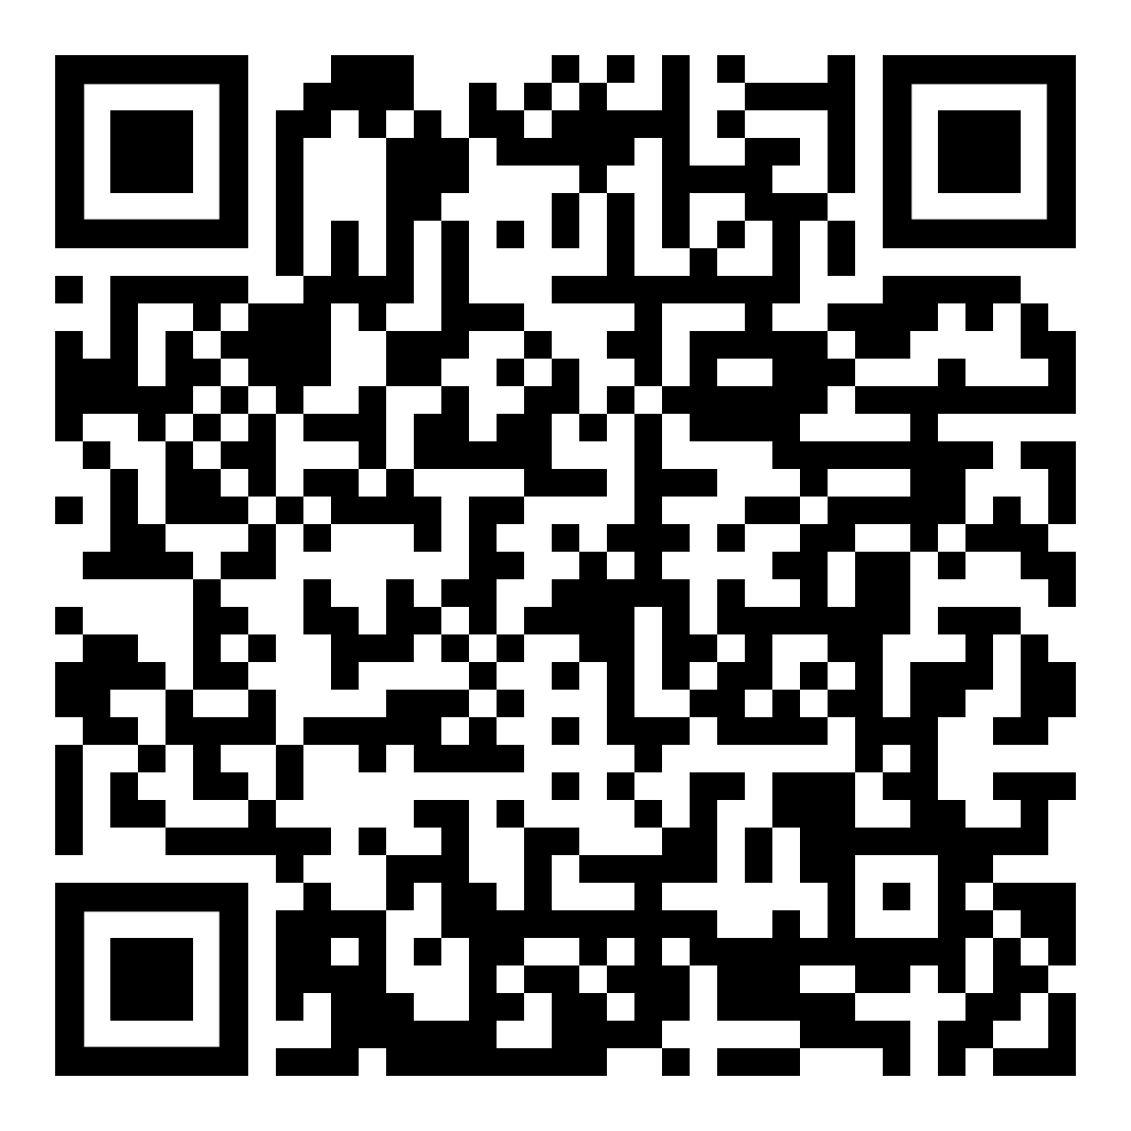
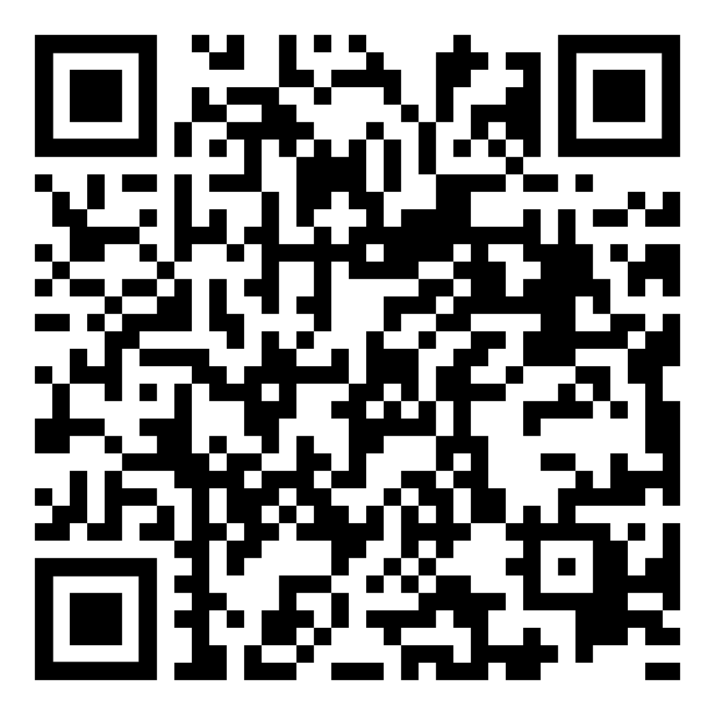
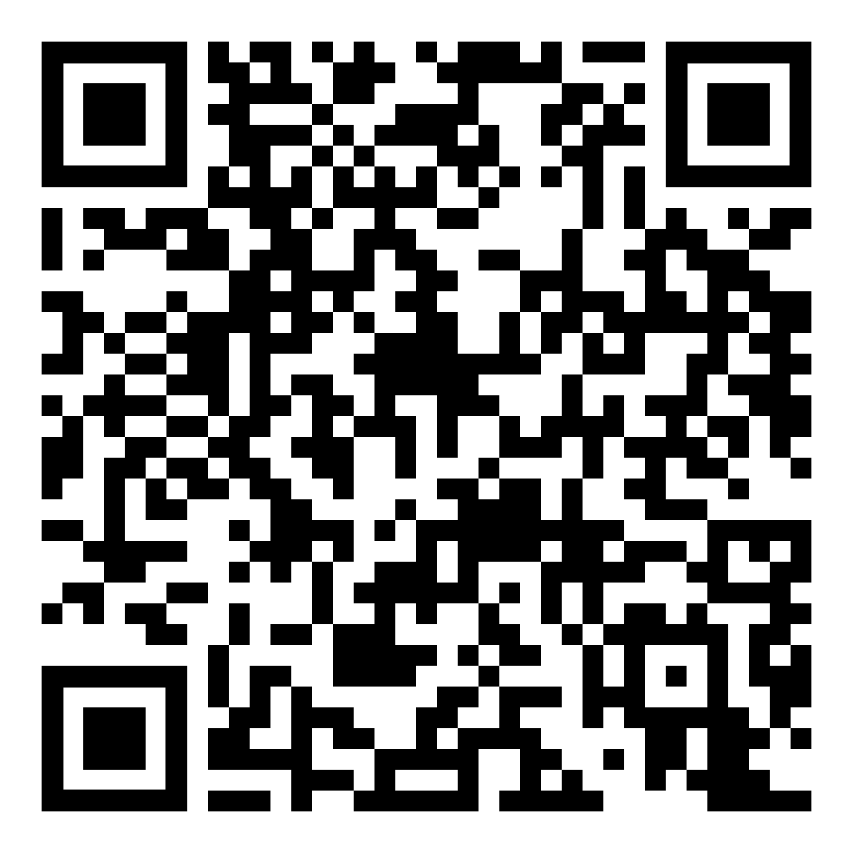
Civic Health Alliance is a nonpartisan coalition of health professionals collaborating to increase the number of our peers and patients registered to vote by November 8, 2022
Vote for the Health of Your Patients
Vote for the Health of Our Democracy
civichealthalliance.org

Slide 3
JOIN THE MOVEMENT: civichealthalliance.org | tw, IG: @civichealth_all | email: info@civichealthalliance.org

Slide 4
THE CIVIC HEALTH ALLIANCE IS A NONPARTISAN COALITION OF HEALTH PROFESSIONALS COLLABORATING TO INCREASE THE NUMBER OF OUR PEERS AND PATIENTS REGISTERED TO VOTE BY NOVEMBER 8, 2022
here's what you can do
check registration status
register to vote
get absentee ballot
civichealthalliance.org

Slide 5
Register to Vote!

